Slide 1



DISCOVERY, REDEFINED
Notes:
Hi im Claud, and I’m the chief hustler at Saivor. Who’s ever been hungry and unsure about what to order? I bet most of us here can relate.

Slide 2



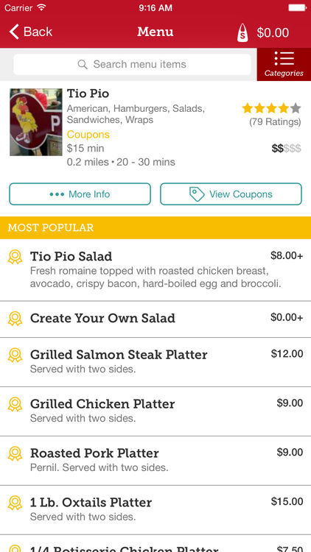



Slide 3
OVERWHELMING
IRRELEVANT
ANNOYING

Slide 4
OVERWHELMING

Slide 5


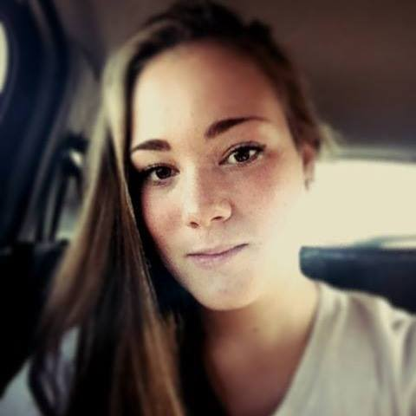
REAL PEOPLE, REAL PROBLEMS
KEV
REGINA
LYNDA
Age: 26
Engineer
Busy lifestyle
Picky eater
Heavy Seamless user
Age: 20
Dog Walker
Values convenience
Gluten-free Diet
Peanut Allergy
Age: 28
Marketer
Social butterfly
Foodie

Slide 6

HOW COME?
😊👌🏼🎶
=
🤔🤷🏻🍕‍♀️
=

Slide 7
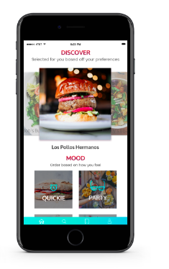

REDEFINING THE WAY YOU DISCOVER FOOD
Notes:
Hi im Claud, and I’m the chief hustler at Saivor. Who’s ever been hungry and unsure about what to order? I bet most of us here can relate.

Slide 8

OUR SOLUTION
Artificial Intelligence
Social Integration
UX/UI

Slide 9
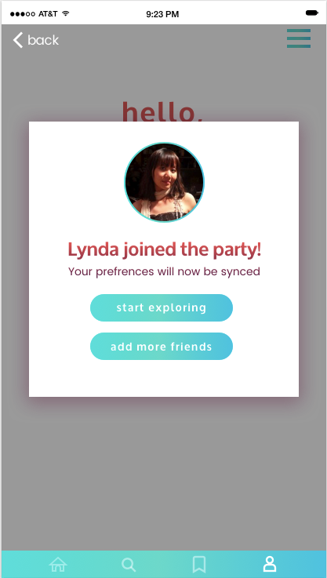
Personalized Options
Explore Top Charts
Trending Meals
Combined Preferences
Bill Splitting
REGINA

Slide 10
TECH ARCHITECTURE

Slide 11
ACCURATE

Slide 12
PERSONAL

Slide 13
$70 Billion industry

Slide 14
30%
Online
Orders
70%
Online
Offline

Slide 15
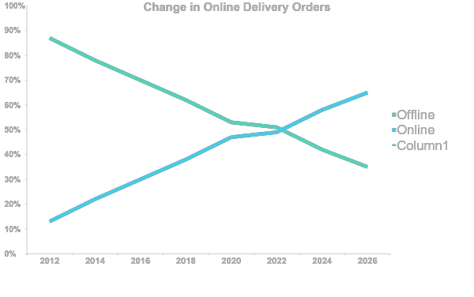
MARKET VALIDATION
65%
30%

Slide 16

















MONTHLY PICK UP ORDER
COMPETITION, NO MATCH
GROUP ORDERING
MEAL KIT DELIVERY
FOOD DELIVERY
FOOD DELIVERY + AI

Slide 17
AI PPOWERED

Slide 18




MEET THE TEAM
CLAUDIO FUENTES
IVA PORFIROVA
Business consulting WeWork Apple
Business
Marketing
AMY VU
HARRISON FERNANDEZ
Design
Technology

Slide 19


special thanks to:
Send love on KickStarter!
www.saivor.us
hello@saivor.us

Slide 20
MARKET VALIDATION
Delivery & Takeout
Industry
Percent from
online/mobile ordering
65%
$70 Billion
30%
2016
2026

Slide 21
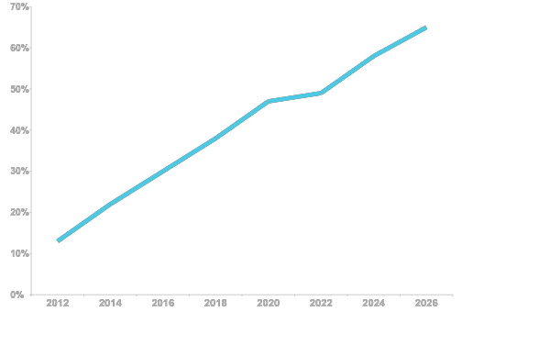
ONLINE ORDERING IS GROWING
65%
116% growth in 10 years
30%

Slide 22








PUBLIC NETWORK
CLOUD NETWORK
IBM BLUE MIX
Security
Push Notifications
Object Storage
Scalable Virtual Servers
API MANAGEMENT

Slide 23
TEAM NOVA
CLAUDIO FUENTES
AMY VU
IVA PORFIROVA
HARRISON FERNANDEZ
Business
Design
Marketing
Technology

